Slide 1
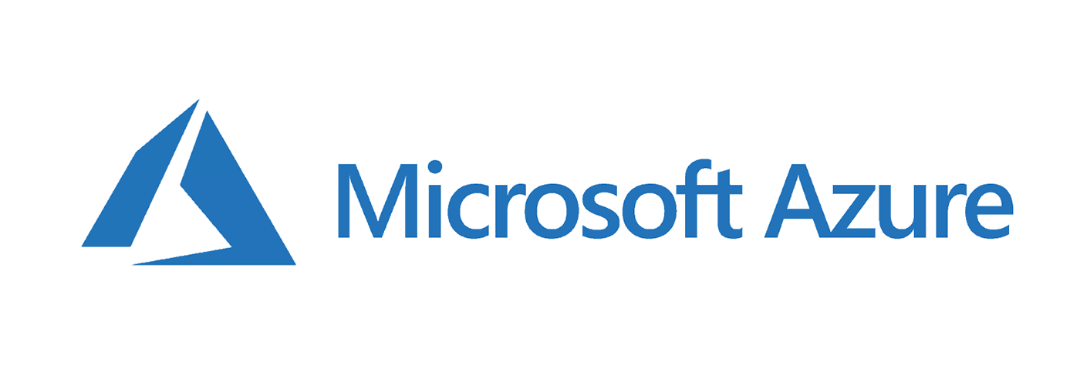

Created By: Ashutosh B. Bodake [.Net Core, Azure, AWS S3]

Slide 2
What is cloud computing?
Cloud Computing is the delivery of computing services over the internet,enabling faster innovation, flexible resources, and economies of scale. It is programble data center.

Slide 3
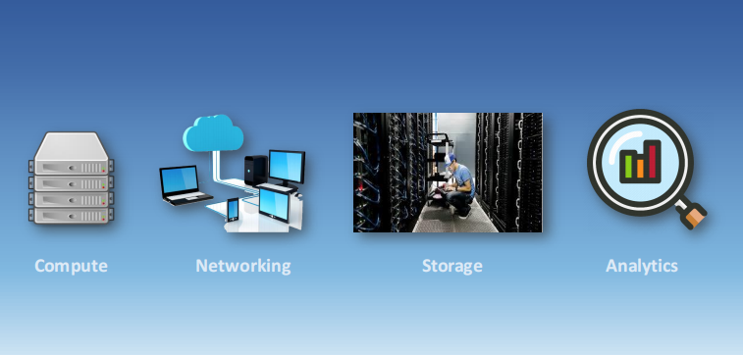

Slide 4
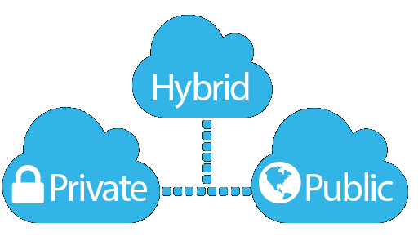
Private cloud
Organizations create a cloud environment in their datacenter.
Organization is responsible for operating the services they provide.
Does not provide access to users outside of the orgnization.
Hybrid Cloud Combines Public and Private clouds to allow applications to run in the
most appropriate location.
Public cloud
• Owned by cloud services or hosting provider.
• Provides resources and services to multiple organizations and users.
• Accessed via secure network connection (typically over the internet).

Slide 5
Cloud model comparison
Public Cloud
No capital expenditures to scale up.
Applications can be quickly provisioned and deprovisioned .
Organizations pay only for what they use.
Hybrid Cloud
Hardwaremust be purchased for start-up and maintenance.
Organizations have complete control over resources and security.
Organizations are responsible for hardware maintenance and updates. Private Cloud
Provides the most flexibility.
Organizations determine where to run their applications.
Organizations control security, compliance or legal requirements.

Slide 6
Cloud Benefits
High availability
Scalability
Global reach
Agility
Disaster recovery
Fault Tolerance
Elasticity
Customer latency Capabilities
Predictive cost considerations
Security

Slide 7

CapEx
Capital Expenditure (CapEx):
Upfront cost on physical infrastructure CapEx computing costs:
Server costs – server clustering, redundant power supplies, and uninterruptible power supplies.
Storage costs – centralized storage and fault-tolerant storage for critical applications.
Network costs – cabling, switches, access points, routers, wide area networks, and Internet connections.
Backup and archive costs – backup maintenance and consumables like tapes.

Slide 8
CapEx
Organization continuity and disaster recovery costs – recover from a disaster and continue operating using backup generators.
Datacenter infrastructure costs – costs for construction and building equipment.
Technical personnel – technical expertise and workforce to install, deploy, and manage the systems in the data center and at the DR site.
Cooling, physical security is the responsibility of the owner.

Slide 9
Consumption-based model
Cloud service providers operate on a consumption-based model, which means that end users only pay for the resources
that they use.
Whatever they use is what they pay for.
Better cost prediction
Prices for individual resources and services are provided
Billing is based on actual usage

Slide 10
OpEx
Operational Expenditure (OpEx)
No upfront cost but you pay for the service/product as you use it
OpEx is particularly appealing if the demand fluctuates or is unknown
OpEX computing costs:
Leasing software and customized features – responsibility to de-provision the resources when they aren’t in use so that you can minimize costs.
Scaling charges based on usage/demand instead of fixed hardware or capacity – plan for backup traffic and disaster recovery traffic to determine the bandwidth needed.
Billing at the user or organization level – when using a dedicated cloud service, you could pay based on server hardware and usage.

Slide 11
Compare CapEx vs. OpEx
Capital Expenditure (CapEx) :
The up-front spending of money on physical infrastructure. Costs from CapEx have
a value that reduces over time.
Operational Expenditure (OpEx) :
Spend on products and services as needed, pay-as-you-go Get billed immediately
has context menu

Slide 12
Cloud Services
Infrastructure-as-a-Service (laaS)
Platform-as-a-Service (PaaS)
Software-as-a-Service (SaaS)
Identify a service type based on a use case
shared responsibility model
server less computing

Slide 13
IaaS, Paas and Saas
Iaas Renting servers, virtual machines, storage, networks, and
operating systemsfrom a cloud provider.
Paas
Provides environment for building, testing, and deploying software applications; without focusing on managing underlying infrastructure.
Saas
Users connect to and use cloud-based apps over the internet for example, Microsoft Office 365, email, and calendars.

Slide 14
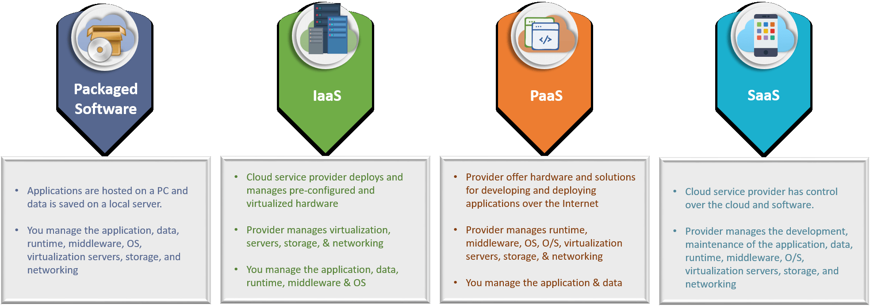
PaaS

Slide 15
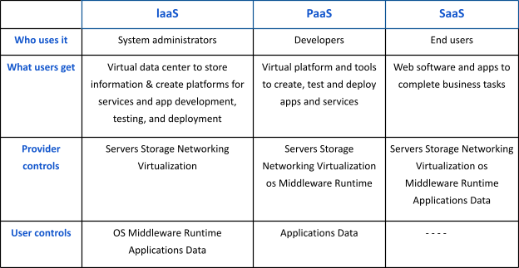

Slide 16

Azure storage
An Azure storage account contains all of your Azure Storage data objects: blobs, files, queues, tables, and disks. The storage account provides a unique namespace for your Azure Storage data that is accessible from anywhere in the world over HTTP or HTTPS. Data in your Azure storage account is durable and highly available, secure, and massively scalable.
Azure Blobs: A massively scalable object store for text and binary data. Also includes support for big data analytics through Data Lake Storage.
Azure Files: Managed file shares for cloud or on-premises deployments.
Azure Elastic SAN: A fully integrated solution that simplifies deploying, scaling, managing, and configuring a SAN in Azure.
Azure Queues: A messaging store for reliable messaging between application components.
Azure Tables: A NoSQL store for schemaless storage of structured data.
Azure managed Disks: Block-level storage volumes for Azure VMs.
Azure Container Storage: A volume management, deployment, and orchestration service built natively for containers.

Slide 17
Pricing Model
Pay-as-you-go pricing model:
You only pay for the cloud services you use most often and it helps
Plan and manage your operating costs.
Run your infrastructure more efficiently.
Scale as your business needs change.
Instead of maintaining CPUs and storage in your data center, you can rent CPUs, storage, and more as and when you need them. The cloud provider takes care of managing the underlying infrastructure for you.

Slide 18
Pricing Model
Azure Reservations:
Azure Reservations helps you save money by committing to one-year or three-year plans for multiple products. Azure Reservation is a long-term contract for a variety of Azure services.
You pay the money monthly or in full upfront, but you can make almost 72% profit compared to pay-as-you-go pricing.
This is good for businesses that have similar usage patterns most of the time.
Azure Spot Instances:
These make use of Microsoft's leftover Compute Capacity.
You can save almost 90% compared to pay-as-you-go pricing, but you should use Spot Instances for mostly stateless periodic workloads.
This suggests that they should only be used when stopping in middle of work is not a problem.
Azure Spot instances - not suitable for a production-based environment.

Slide 19

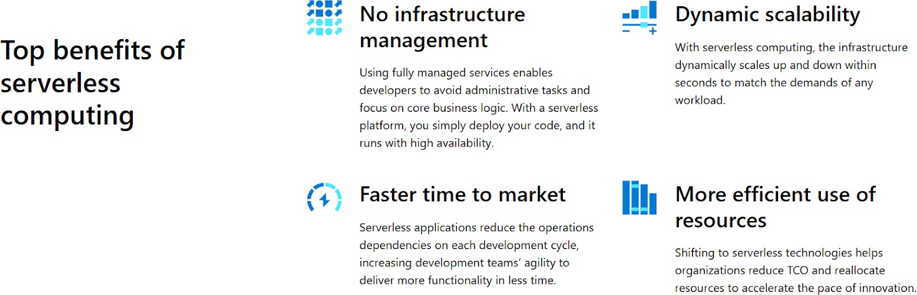
Azure Serverless Services Overview
Serverless computing allows developers to accelerate application development by removing the necessity of infrastructure management. In the context of serverless applications, the cloud service provider takes on the responsibility of automatically provisioning, scaling, and overseeing the infrastructure needed to execute the code.

Slide 20
Azure Functions (Serverless):
Azure Functions is a serverless computing service that is available in Azure. It supports a variety of development languages, such as C#, F#, Node.js, Java, or PHP.
Like many Cloud Services, it uses a pay-as-you-go model. It is possible to connect it with a variety of Azure services. Charges are only incurred when a function is triggered, and also, Azure Functions scales automatically.
We can execute the small pieces of code using Azure Functions without having to worry about the underlying infrastructure.
If you want to | Then
Build a web API | Using the HTTP trigger, create an endpoint for your web apps.
Build a serverless workflow | Utilizing durable functions, chain a sequence of functions together.
Respond to database changes | When a document is generated or modified in Cosmos DB, run custom logic.
Process data in real-time | Use SignalR and Functions to react to data in real time.

Slide 21
Azure Core Architectural components
Azure regions, Region pairs, and Sovereign regions
Azure Regions:
A region is a geographical location on the globe with at least one, but possibly many, data centers close by and connected by a low-latency network.
When you create a resource in Azure, you must define the location/region to which it should.
belong. There are a few exceptions, such as Azure DNS, but generally, all resources must be created with a location specified.
Azure makes it simple to select the data center and regions appropriate for you and your clients, with more announced regions than any other cloud provider (60+).

Slide 22
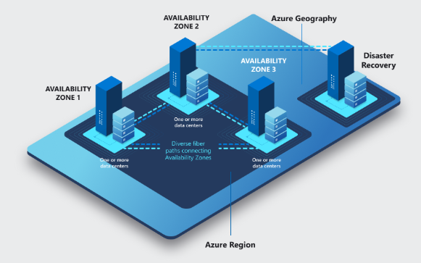
Azure Region Pairs:
Azure Region Pair is a relationship between two Azure Regions within the same geographic location for disaster recovery purposes.
Azure regions are paired with other regions in the same geography at least 300 miles away.
This approach allows for the replication of resources across geography to help mitigate disruptions due to events such as natural disasters, civil unrest, power outages, or physical network outages affecting the entire region.

Slide 23
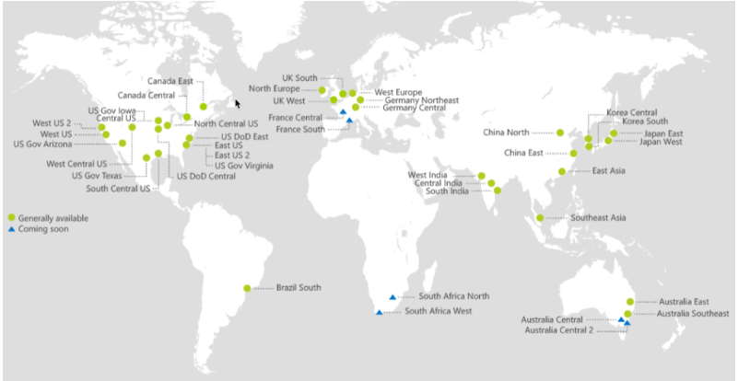

Slide 24
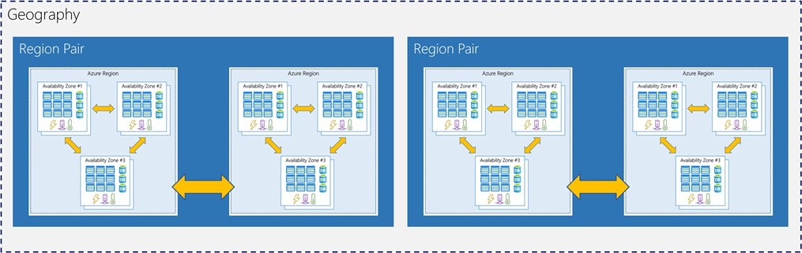
Ex: if a region in a pair was affected by a natural disaster, services would automatically failover to the other region(2nd Region) in its region pair.

Slide 25
Sovereign Regions:
Azure Sovereign regions are dedicated to specific sovereign entities.
These cloud regions are isolated in-country platforms with independent authentication, storage, and compliance requirements.
They are not necessarily managed by Microsoft and may be restricted to certain types of customers. Examples: Azure China 21Vianet, Azure Germany, Azure Government - the US, Australia Azure Availability Zones and Datacentres
Azure Datacentres
Datacentres are unique physical buildings like a group of networked computer servers.
It contains several physical servers with their own power, cooling, & networking infra.
Individual datacentres aren’t directly accessible.
Azure Datacentres are grouped into Azure Regions/Availability Zones that are designed to help you achieve resiliency and reliability for your business-critical workloads.

Slide 26
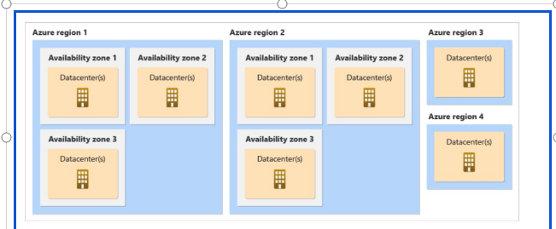
Azure Availability Zones
Within an Azure region, availability zones are physically distinct data centers.
Each availability zone comprises one or more data centers that are self-contained in terms of power, cooling, and networking.
Availability zones are connected through high-speed, private fiber-optic networks.
The goal of having more than one availability zone in a region is to allow data to be redundantly stored in more than one availability zone, ensuring that even if a data center fails, it does not affect our resources.

Slide 27
Azure Resources and Resource groups
Azure Resources:
A resource is something that is used to manage services in Azure.
At any one moment, a resource can only be in one resource group.
The final component in the Azure architectural hierarchy is the resource.
A resource group and a resource can be in two different locations; there is no restriction.
Azure Resource Group:
A resource group is the next level in the hierarchy of Azure Architecture. A resource group is the logical mapping of the resources.
For Creating Any Resource, you need a resource group.
An Azure Management group is optional. However, azure resource groups and subscriptions are required. Resource groups can’t be nested.

Slide 28
Azure Subscriptions and Management Groups
Azure Subscriptions
As the name implies, a subscription is a logical entity that grants access to deploy and consume Azure resources.
A resource may be anything from a virtual machine to a storage account or something that's related to networking.
Almost anything in Azure can be utilized as a resource.
A subscription is something that can be purchased and used for a certain amount of time. The same is true for Azure subscriptions.
Azure Management Groups
A company may use Azure management groups to govern and manage access, compliance, and
rules for their subscription inside their tenancy.

Slide 29
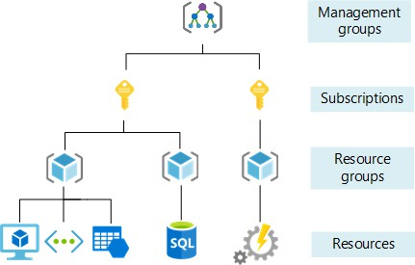
Azure Subscriptions and Management Groups
An Azure management group comes above the Azure subscription in the hierarchy of management of resources in Azure.
A subscription can only have one management group.

Slide 30
Azure Storage Services
Azure Storage Types
Azure Storage includes massively scalable object storage for data objects, a cloud file system, a messaging store for secure communications, and a NoSQL store. Azure Storage accounts are extremely durable and available.
Blob Storage:
Blob Storage is useful for storing videos, images, large files, log files, etc. Blob storage stores things in the form of objects.
Table Storage:
It is a low-cost method of storing table-like data for applications. This type of storage is key-attribute storage and is most significantly utilized for NoSQL data.
File Storage:
File Storage uses the Server Message Block Protocol to retrieve files. It can be used to mount file shares on Windows, Linux, and Mac machines.
Queue Storage:
It is a messaging service offered by Azure. It is used to retrieve and save messages. A queue may hold millions of messages.

Slide 31
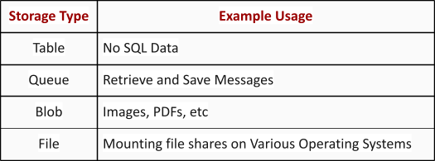
Azure Storage Services

Slide 32
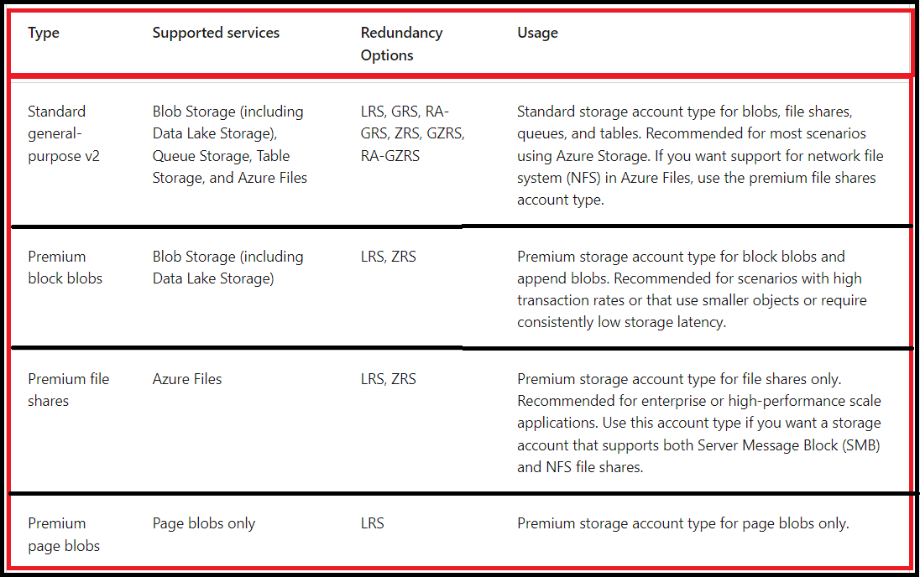
Azure Storage Services

Slide 33
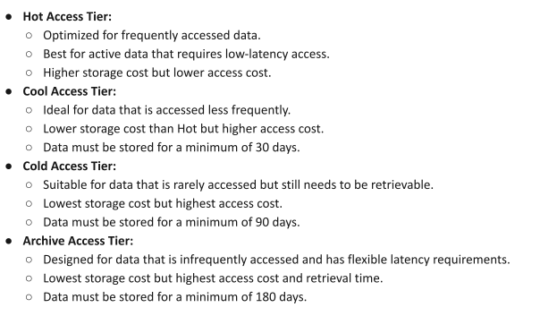
Azure Storage Tiers and Redundancy Options

Slide 34
Azure Storage Tiers and Redundancy Options
Choosing the Right Tier
➔Access Frequency: How often is the data accessed?
➔Data Retention: How long do you need to retain the data?
➔Performance Requirements: What are the latency and throughput needs?
Cost Sensitivity: What is your budget for storage and access costs?

Slide 35
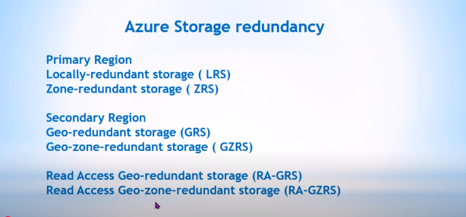
Azure Storage Redundency

Slide 36
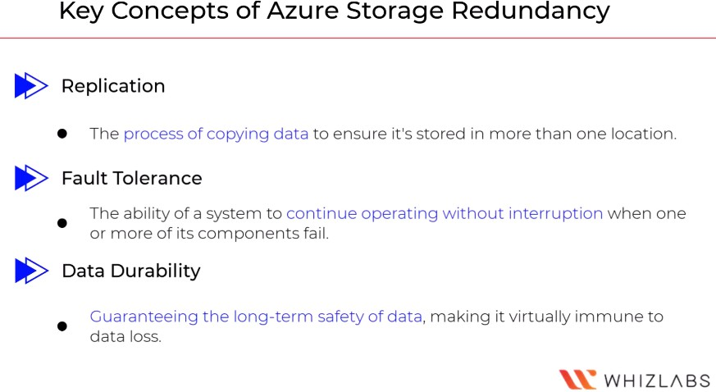
Azure Redundancy options
Azure Storage always stores multiple copies of your data so that it's protected from planned and unplanned events such as transient hardware failures, network or power outages, and natural disasters. Redundancy ensures - your storage account meets its availability and durability goals even in failures.

Slide 37
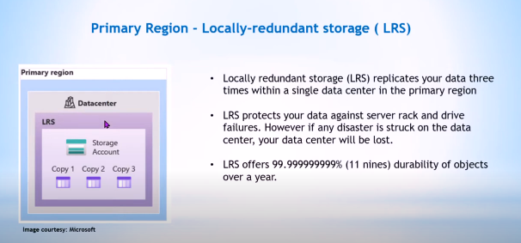
LRS

Slide 38
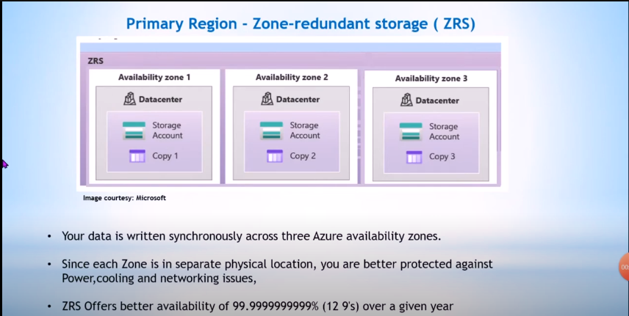
ZRS

Slide 39
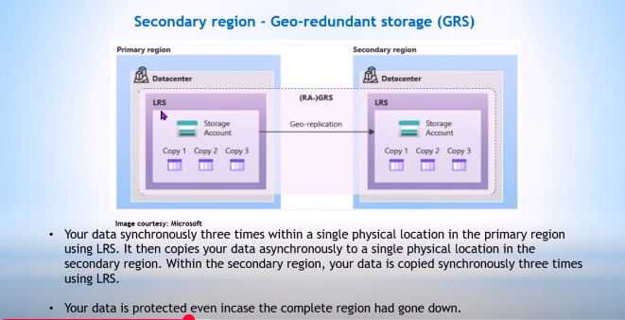
GRS
Availability of 99.9999999999999999 (16 9’s)

Slide 40
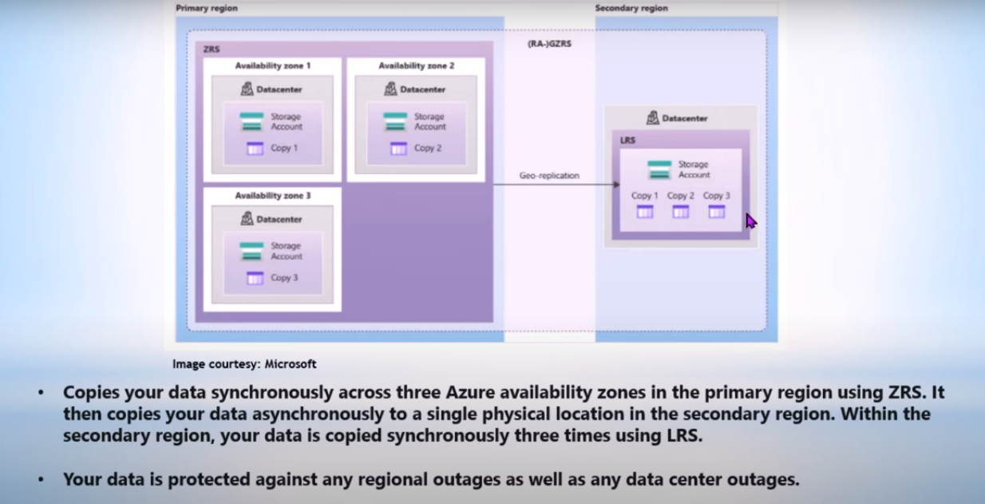
GZRS
Availability of 99.9999999999999999 (16 9’s)

Slide 41
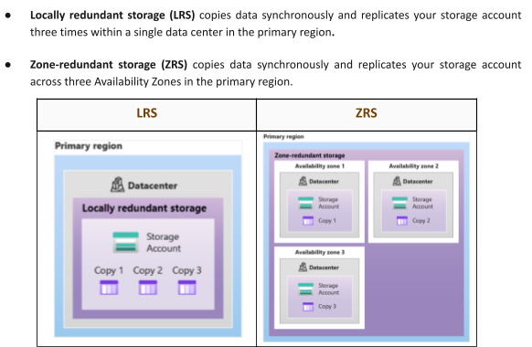
Redundancy in the primary region:-

Slide 42
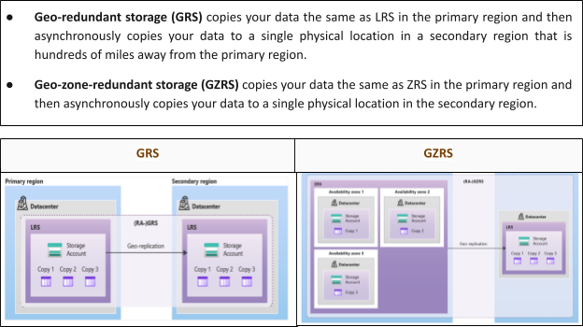
Redundancy in the secondary region:-

Slide 43
Azure Identity, Access, and Security
Microsoft Entra comprises a suite of identity and network access solutions. It empowers organizations to adopt a Zero Trust security framework and develop a trust fabric that authenticates identities, assesses access conditions, verifies permissions, secures connection channels through encryption, and conducts compromise monitoring.
The Microsoft Entra suite addresses four levels of maturity in ensuring secure end-to-end access for any reliable identity. These levels encompass the implementation of zero-trust access controls and the safeguarding of access for employees, customers, partners, and various cloud environments.

Slide 44
Azure Key Vaults
Azure Key Vault is a cloud service for storing and safely accessing secrets.
It is used for key management, secret management, certificate management, and storing secrets supported by hardware models.
Azure Key Vault can centralize application secrets, monitor access, and use, and simplifies resource management.

Slide 45
Azure Service Bus
Azure Service Bus is a fully managed messaging service provided by Microsoft Azure that enables reliable and scalable communication between different applications, services, or components, whether they are running in the cloud or on-premises.
It facilitates asynchronous message delivery, allowing decoupled systems to communicate effectively. Service Bus supports multiple messaging patterns, including queues, which ensure point-to-point communication (with one message processed by one receiver), and topics and subscriptions, which enable publish-subscribe messaging (allowing messages to be broadcast to multiple receivers).
This service is highly useful for building distributed systems, handling complex workflows, and ensuring high availability and fault tolerance by providing message storage until processing is complete.
Additionally, it offers features such as message ordering, duplication detection, and dead-lettering, making it an essential component for enterprise-grade messaging solutions.

Slide 46
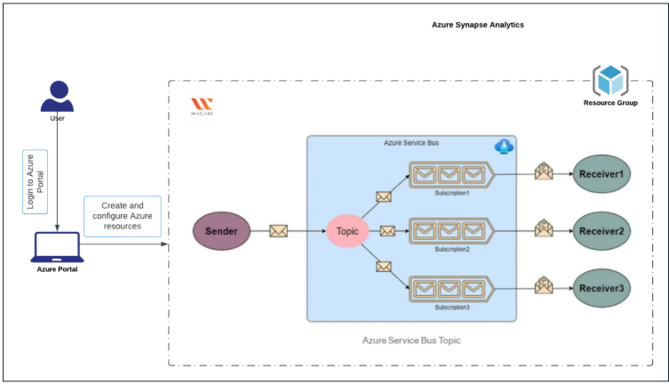
Azure Service Bus
Architecture Diagram

Slide 47
Azure Service Bus
Task Details
Sign in to Azure Portal
Create a Service Bus namespace
Get connection string to the namespace
Create a topic and subscription using the Azure portal
Send messages to the Service Bus topic
Validation test
Delete the Resources

Slide 48
Logic Apps
What is Azure Logic Apps?
Azure Logic Apps is a cloud service. Using Logic Apps defines the workflow at ease consuming a range of APIs exposed as Connectors. These Logic App connectors will perform the sequence of actions defined in the workflow whenever the trigger gets fired. Few Scenarios: Schedule and send email notifications using Office 365 when a specific event happens, for example, a new file is uploaded.
Route and process customer orders across on-premises systems and cloud services.
Move uploaded files from an SFTP or FTP server to Azure Blob Storage.
Monitor social media activity, analyze the sentiment, and create alerts or tasks for items that need review.

Slide 49
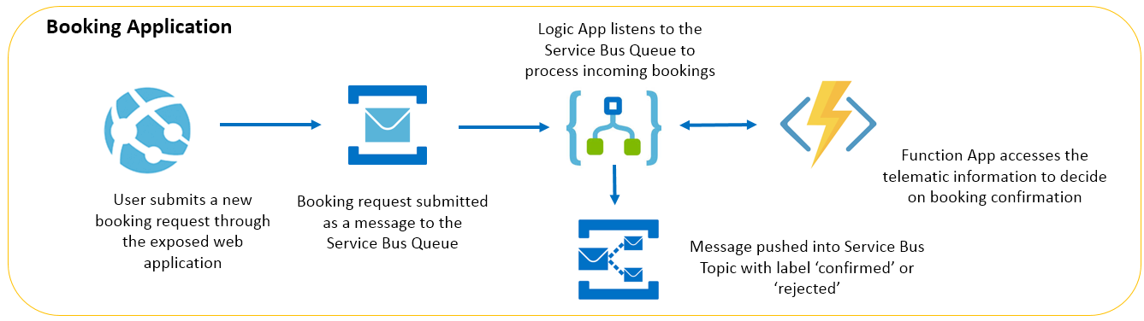
Logic App

Slide 50
Azure Advisor
A service that provides personalized best practices and recommendations to help
optimize your Azure resources for cost, security, performance, and reliability.

Slide 51
Azure App Service
It allows you to develop and host web apps, mobile back ends, and RESTful
APIs in your preferred programming language without the need to manage infrastructure.

Slide 52
Azure Monitor
Azure Monitor helps you maximize the availability and performance of your applications and services. It delivers a comprehensive solution for collecting, analyzing, and acting on telemetry from your cloud and on-premises environments. This information helps you understand how your applications are performing and proactively identify issues that affect them and the resources they depend on.
Application Insights is a feature of Azure Monitor that provides extensible application performance management (APM) and monitoring for live web apps. It also supports a wide variety of platforms, including .NET, Node.js, Java, Python and works for apps hosted on-premises, hybrid, or on any public cloud.

Slide 53
Azure Monitor
Application Insights provides other features including, but not limited to:
– Live Metrics: observe activity from your deployed application in real time with no effect on the host environment
– Availability: also known as Synthetic Transaction Monitoring, probe your application’s external endpoint(s) to test the overall availability and responsiveness over time
– GitHub or Azure DevOps integration: create GitHub or Azure DevOps work items in context of Application Insights data
– Usage: understand which features are popular with users and how users interact and use your application
– Smart Detection – automatic failure and anomaly detection through proactive telemetry analysis

Slide 54
Azure Arc
Companies struggle to control and govern increasingly complex environments that extend across data centers, multiple clouds, and edge. Each environment and cloud possesses its own set of management tools, and new DevOps and ITOps operational models can be hard to implement across resources.
Azure Arc simplifies governance and management by delivering a consistent multi-cloud and on-premises management platform.

Slide 55
Microsoft Sentinel
Microsoft Sentinel is a scalable, cloud-native, security information event management (SIEM) and security orchestration automated response (SOAR) solution. Microsoft Sentinel delivers intelligent security analytics and threat intelligence across the enterprise, providing a single solution for alert detection, threat visibility, proactive hunting, and threat response.
Microsoft Sentinel is your birds-eye view across the enterprise alleviating the stress of increasingly sophisticated attacks, increasing volumes of alerts, and long resolution timeframes.
– Collect data at cloud scale across all users, devices, applications, and infrastructure, both on-premises and in multiple clouds.

Slide 56
Microsoft Sentinel
Detect previously undetected threats, and minimize false positives using Microsoft’s analytics and unparalleled threat intelligence.
Investigate threats with artificial intelligence, and hunt for suspicious activities at scale, tapping into years of cybersecurity work at Microsoft.
Respond to incidents rapidly with built-in orchestration and automation of common tasks.

Slide 57
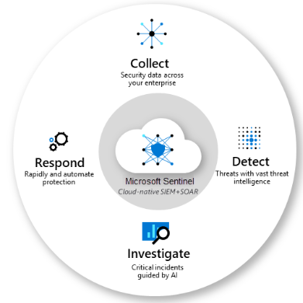
Microsoft Sentinel

Slide 58

Azure Virtual Machines
Azure Virtual Machines are image service instances that provide on-demand and scalable computing resources with usage-based pricing. More broadly, a virtual machine behaves like a server: it is a computer within a computer that provides the user with the same experience they would have on the host operating system itself.

Slide 59
Azure status
Azure status informs you of service outages in Azure on the Azure Status page. The page is a global view of the health of all Azure services across all Azure regions. The status page is a good reference for incidents with widespread impact, but Azure strongly recommends that the current Azure users leverage Azure service health to stay informed about Azure incidents and maintenance.

Slide 60
Service health
Service health provides a personalized view of the health of the Azure services and regions you’re using. This is the best place to look for service-impacting communications about outages, planned maintenance activities, and other health advisories because the authenticated Service Health experience knows which services and resources you currently use. The best way to use Service Health is to set up Service Health alerts to notify you via your preferred communication channels when service issues, planned maintenance, or other changes may affect the Azure services and regions you use.

Slide 61
Resource health
Resource health provides information about the health of your individual cloud resources, such as a specific virtual machine instance. Using Azure Monitor, you can also configure alerts to notify you of availability changes to your cloud resources. Resource Health, along with Azure Monitor notifications, will help you stay better informed about the availability of your resources minute by minute and quickly assess whether an issue is due to a problem on your side or related to an Azure platform event.

Slide 62
Microsoft Purview
Microsoft Purview is designed to help organizations identify, classify, and govern sensitive data across their entire environment, including both on-premises and cloud-based systems. It provides data discovery capabilities, supports the classification of sensitive information, and implements governance policies. With Purview, organizations can maintain compliance with regulatory requirements and ensure data security by using features such as data classification, sensitivity labels, and automated data management.

Slide 63
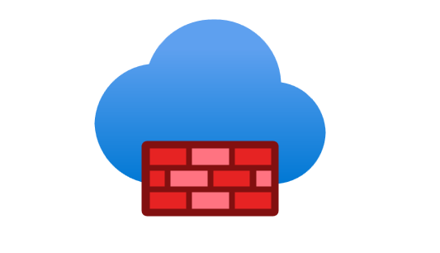
Azure Firewall
Azure Firewall doesn’t use IPSec and can’t be used to connect Azure resources and your on-premises network. It is just a fully stateful firewall-as-a-service that allows you to centrally create, enforce, and log application and network connectivity policies across subscriptions and Azure virtual networks.
You can centrally create, enforce, and log application and network connectivity policies across subscriptions and virtual networks. Azure Firewall uses a static public IP address for your virtual network resources allowing outside firewalls to identify traffic originating from your virtual network. The service is fully integrated with Azure Monitor for logging and analytics.

Slide 64
Network Security Group
Network security group is primarily used to filter network traffic to and from Azure resources in an Azure virtual network. You have to establish a VPN connection if you need to connect between the Azure virtual network and your home computer via IPSec.
TAP(Terminal Access Point):- this just allows you to continuously stream your virtual machine network traffic to a network packet collector or analytics tool.
Azure ExpressRoute connection:- this service is primarily used to create private connections between Azure and your on-premises network or in a colocation environment.

Slide 65
Azure Service Health
It ofers a range of experiences that provide personalized guidance and support whenever issues in Azure services arise or have the potential to afect you in the future.
Azure Service Health is a combination of three separate smaller services: Azure Status, Service Health, and Resource Health.

Slide 66
Azure Service Health
Azure Status informs you of service outages in Azure on the Azure Status page. The page is a global view of the health of all Azure services across all Azure regions. The status page is a good reference for incidents with widespread impact, but we strongly recommend that current Azure users leverage Azure service health to stay informed about Azure incidents and maintenance.
Service Health provides a personalized view of the health of the Azure services and regions you’re using. This is the best place to look for service-impacting communications about outages, planned maintenance activities, and other health advisories because the authenticated Service Health experience knows which services and resources you currently use. The best way to use Service Health is to set up Service Health alerts to notify you via your preferred communication channels when service issues, planned maintenance, or other changes may affect the Azure services and regions you use.

Slide 67
Azure Service Health
Resource Health provides information about the health of your individual cloud resources, such as a specific virtual machine instance. Using Azure Monitor, you can also configure alerts to notify you of availability changes to your cloud resources. Resource Health along with Azure Monitor notifications, will help you stay better informed about the availability of your resources minute by minute and quickly assess whether an issue is due to a problem on your side or related to an Azure platform event.

Slide 68
Azure Advisor
this service only analyzes your configurations and usage telemetry to offer personalized and actionable recommendations to help you optimize your Azure resources for reliability, security, operational excellence, performance, and cost. It doesn’t provide information about the planned maintenance, incidents, and other service outages in Azure that may affect your virtual machine and other related services.

Slide 69
Azure Service Fabric
this is just a distributed systems platform in Azure that makes it easy for you to package, deploy, and manage scalable and reliable microservices and containers.

Slide 70
Azure Analysis Services
this is simply a fully managed platform as a service (PaaS) that provides enterprise-grade data models in the cloud and not a monitoring service.

Slide 71
Azure Cloud Shell
It is a browser-accessible terminal that provides an interactive and authenticated
environment for managing Azure resources.

Slide 72
Azure Availability Zones
Physical data center locations within a region, each with independent power, cool_x0002_ing, and networking, are designed to provide fault tolerance and high availability for Azure resources.

Slide 73
Azure Cosmos
A globally distributed, multi-model database service that supports document, key-value, graph, and column-family data models.

Slide 74
Azure Cosmos
Key Features and Benefits:
Global Distribution:
Cosmos DB can be deployed across multiple Azure regions, enabling data replication and low-latency access for users worldwide.
Multi-Model Database:
It supports multiple data models (NoSQL, relational, and vector), allowing developers to choose the best model for their specific needs.
High Availability and Scalability:
Cosmos DB offers high availability and scalability, ensuring that your applications remain operational even during outages or high traffic.
Low Latency:
Designed to provide low-latency access to data, ensuring fast response times for your applications.
Fully Managed Service:
Cosmos DB is a fully managed service, meaning Microsoft handles the underlying infrastructure, including backups, patching, and scaling.

Slide 75
Azure Cosmos
Flexible Consistency Models:
Offers multiple consistency models, allowing developers to balance consistency and performance based on their application requirements.
Support for Various APIs:
Supports multiple APIs, including NoSQL, SQL, MongoDB, Apache Cassandra, and more, allowing developers to leverage their existing skills and tools.
Automatic Scaling:
Cosmos DB automatically scales to meet the demands of your application, ensuring optimal performance and cost-effectiveness.
Cost-Effective Pricing:
Offers a flexible pricing model that allows you to pay only for the resources you use, with options for serverless and automatic scaling.
Free Tier:
Provides a free tier for developers to experiment with the service and get started with minimal cost

Slide 76
Azure Cosmos
Use Cases:
Building globally distributed applications:
Cosmos DB's global distribution capabilities make it ideal for applications that need to serve users worldwide.
Storing and managing unstructured data:
Its support for NoSQL data models makes it suitable for applications that need to store and manage large amounts of unstructured data.
Developing high-performance applications:
Its high availability, scalability, and low-latency features make it ideal for applications that require high performance and reliability.
Creating AI-powered applications:
Cosmos DB can be used to store and manage the data used by AI applications.
Building modern web and mobile applications:
Its flexible data models and APIs make it suitable for a wide range of modern web and mobile applications.

Slide 77
Azure Disks
These are block-level storage volumes designed for use with Azure Virtual Machines.

Slide 78
Azure Files
A fully managed fle shares in the cloud, accessible through the standard Server Message Block (SMB) protocol, Network File System (NFS) protocol, and Azure Files REST API.

Slide 79
Azure Government
It provides a specialized cloud platform that allows government agencies and their partners to migrate mission-critical workloads to the cloud.

Slide 80
Azure Information Protection
It ofers the encryption service, Azure Rights Management, which is utilized by Microsoft Purview Information Protection.

Slide 81
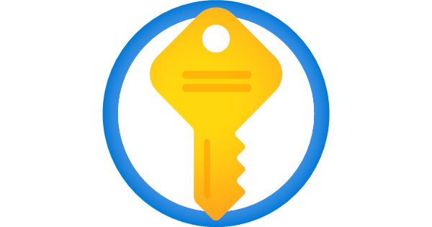
Azure Key Vault
Azure Key Vault is a cloud service that securely stores and manages secrets like API keys, passwords, certificates, and cryptographic keys, offering centralized control and enhanced security for cloud applications and services.

